Slide 1

Project 1: SAT and ACT scores analysis
By Andrew Chia – SG DSI 23

Slide 2
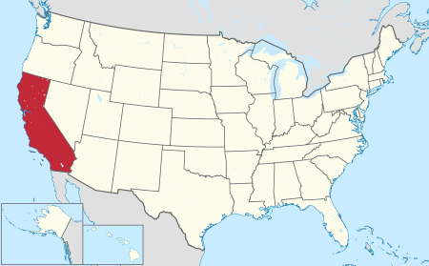
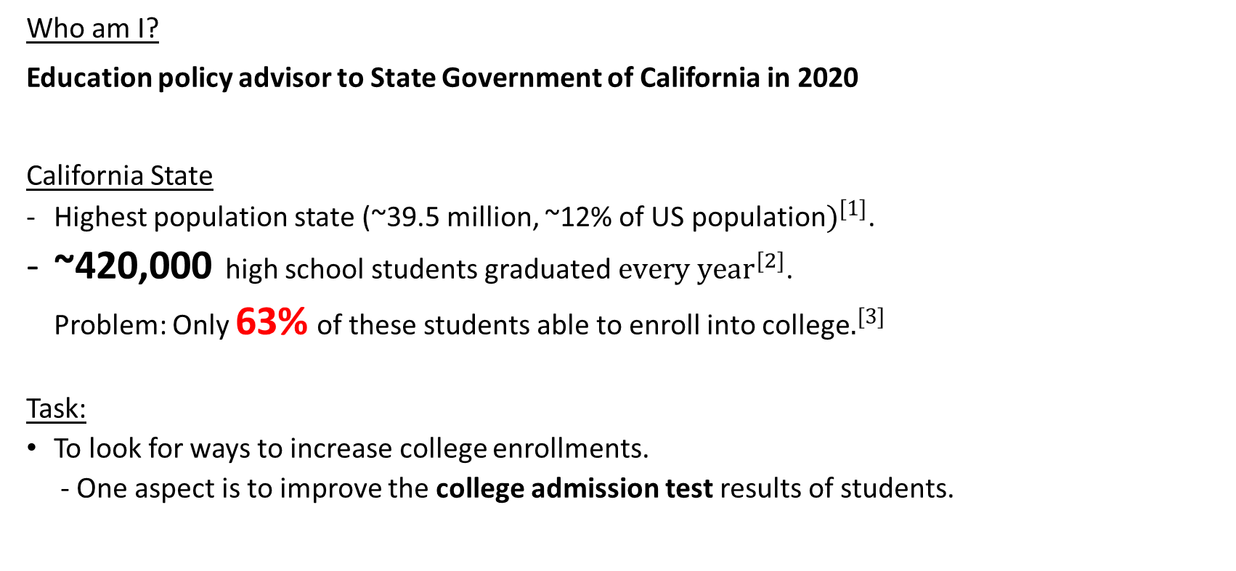
Background of Project
Who am I?
Education policy advisor to State Government of California in 2020
California State
Highest population state (~39.5 million, ~12% of US population$)^{[1]}$.
~420,000 high school students graduated${ every year}^{[2]}$.
Problem: Only 63% of these students able to enroll into college$.^{[3]}$
Task:
To look for ways to increase college enrollments.
- One aspect is to improve the college admission test results of students.
[1] US Census Bureau, Quick Facts https://www.census.gov/quickfacts/CA
[2] US National Center for Education Statistics https://nces.ed.gov/programs/digest/d16/tables/dt16_219.20.asp
[3] Where California High School students attend college, Policy Analysis for California Education https://edpolicyinca.org/sites/default/files/Statewide%20NSC%20Report%20Final%20Online.pdf

Slide 3


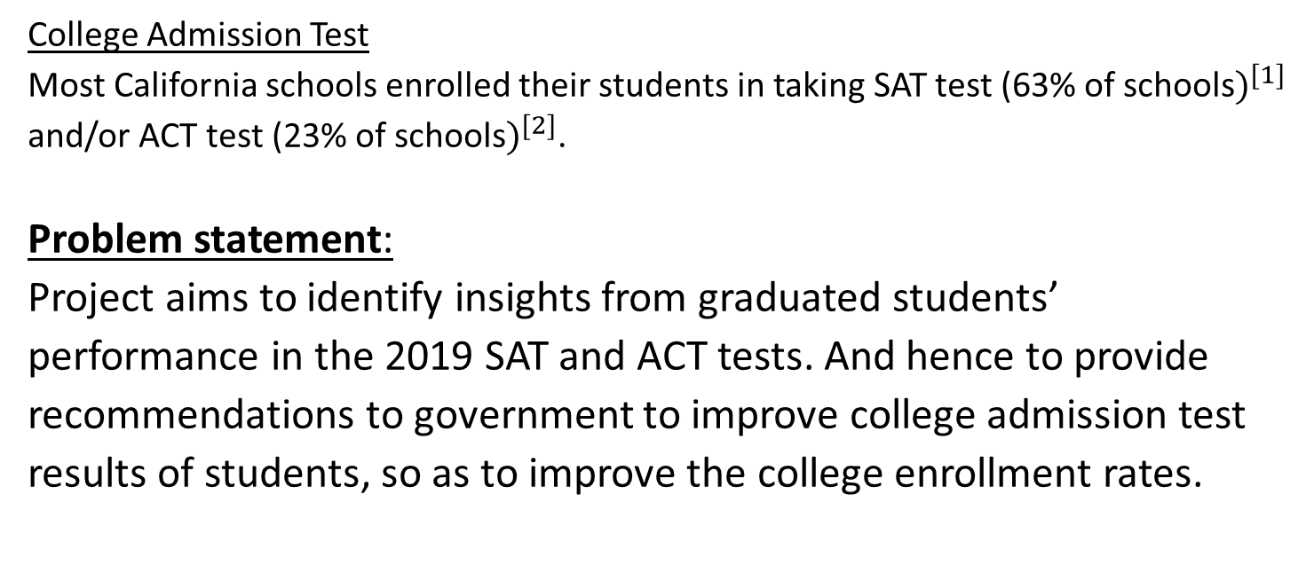
Background of Project
College Admission Test
Most California schools enrolled their students in taking SAT test (63% of schools$)^{[1]}$ and/or ACT test (23% of schools$)^{[2]}$.
Problem statement:
Project aims to identify insights from graduated students’ performance in the 2019 SAT and ACT tests. And hence to provide recommendations to government to improve college admission test results of students, so as to improve the college enrollment rates.
[1] 2019 SAT Scores by State https://blog.prepscholar.com/average-sat-scores-by-state-most-recent
[2] 2019 ACT Scores by State https://blog.prepscholar.com/act-scores-by-state-averages-highs-and-lows

Slide 4
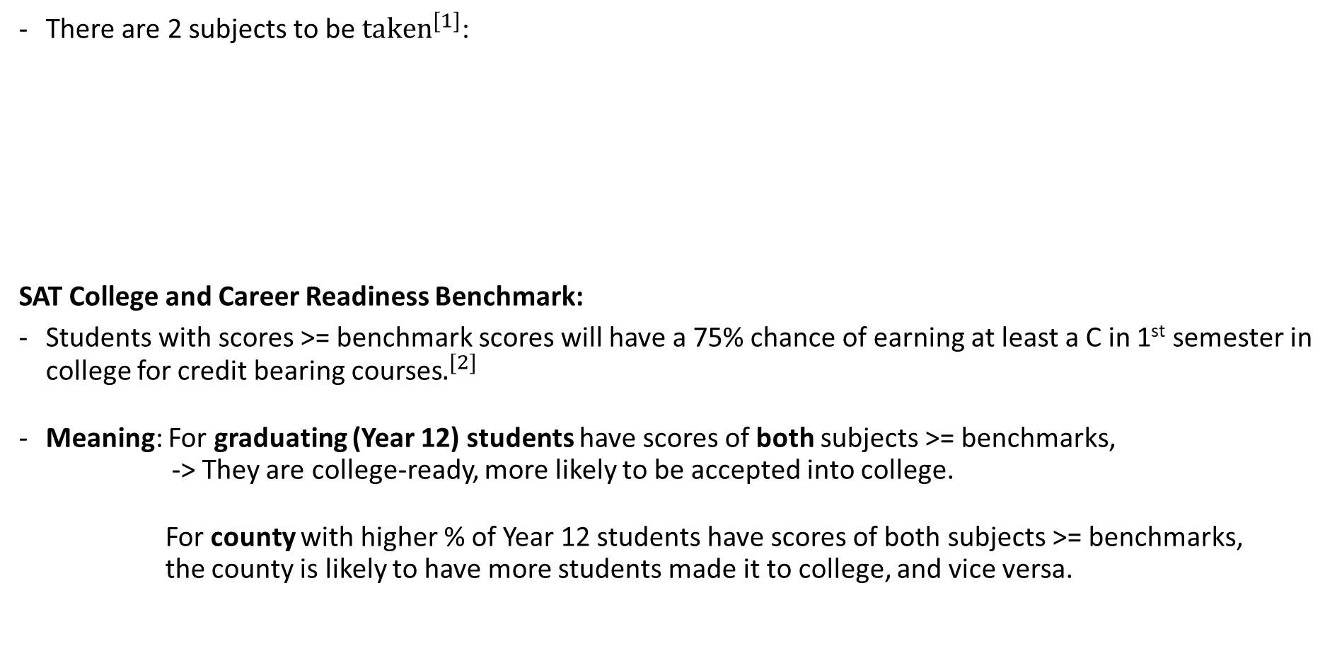
SAT Test
There are 2 subjects to be ${taken}^{[1]}$:
SAT College and Career Readiness Benchmark:
Students with scores >= benchmark scores will have a 75% chance of earning at least a C in 1st semester in college for credit bearing courses$.^{[2]}$
Meaning: For graduating (Year 12) students have scores of both subjects >= benchmarks,
-> They are college-ready, more likely to be accepted into college.
For county with higher % of Year 12 students have scores of both subjects >= benchmarks,
the county is likely to have more students made it to college, and vice versa.
Subjects | Score Range | SAT College and Career Readiness Benchmarks
Evidence-based Reading and Writing (ERW) | 200 - 800 | 480
Math | 200 - 800 | 530
Total | 400 - 1600 | 1110
[1] Inside the SAT test, https://collegereadiness.collegeboard.org/sat/inside-the-test
[2] SAT College and Career Readiness Benchmarks https://collegereadiness.collegeboard.org/about/scores/benchmarks

Slide 5
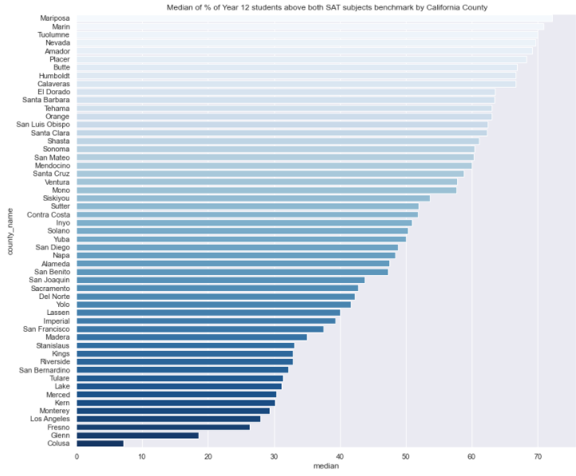
*ERW Benchmark for Year 12 Students: 480
*Math Benchmark for Year 12 Students: 530
SAT Test (County Analysis)
Among the 53 counties in California, the bottom 5 counties in terms of median % of Year 12 students achieving scores above benchmarks for both subjects:
Colusa - 7.1%
Glenn – 8.5%
Fresno – 26.3%
Los Angeles – 27.9%
Monterey – 29.3%

Slide 6
*ERW Benchmark for Year 12 Students: 480
*Math Benchmark for Year 12 Students: 530
SAT Test (County Analysis)
Among the 53 counties in California, the bottom 5 counties in terms of median % of Year 12 students achieving scores above benchmarks for both subjects:
Colusa - 7.1%
Glenn – 8.5%
Fresno – 26.3%
Los Angeles – 27.9%
Monterey – 29.3%
Recommendations:
Focus on allocating more and higher quality teaching resources to these 5 counties in urgent need.

Slide 7
*ERW Benchmark for Year 12 Students: 480
*Math Benchmark for Year 12 Students: 530
SAT Test (County Analysis)
Among the 53 counties in California, the bottom 5 counties in terms of median % of Year 12 students achieving scores above benchmarks for both subjects:
Colusa - 7.1%
Glenn – 8.5%
Fresno – 26.3%
Los Angeles – 27.9%
Monterey – 29.3%
Recommendations:
Focus on allocating more and higher quality teaching resources to these 5 counties in urgent need.
If there are additional teaching resources, the government can also focus on the next 12 counties which have 30-40% of median % of Year 12 students achieving scores above benchmarks for both subjects.

Slide 8
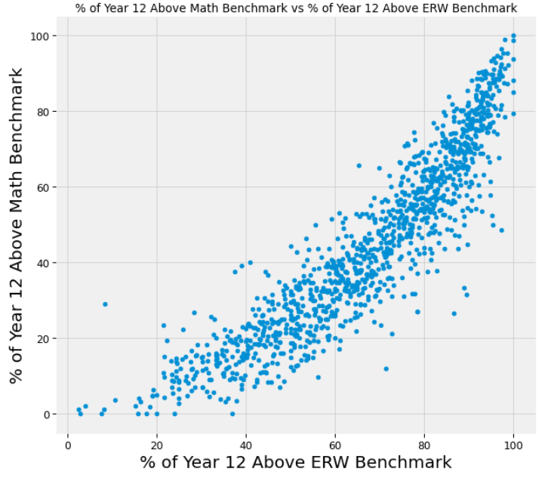
*ERW Benchmark for Year 12 Students: 480
*Math Benchmark for Year 12 Students: 530
SAT Test (Subject Analysis)
Which subject’s teaching resources should government be providing to Year 12 students?
Based on a correlation study between % of Year 12 above math benchmark vs % of Year 12 above ERW benchmark, there is a strong +ve linear correlation (r=0.91), indicating that students with weak ERW background could possibly have weak Math background as well.
Recommendation
1. For students in need, the state will need to provide additional and higher quality teaching resources for both Math and ERW.
1
1

Slide 9
*ERW Benchmark for Year 12 Students: 480
*Math Benchmark for Year 12 Students: 530
SAT Test (Subject Analysis)
Which subject’s teaching resources should government be providing to Year 12 students?
Based on a correlation study between % of Year 12 above math benchmark vs % of Year 12 above ERW benchmark, there is a strong +ve linear correlation (r=0.91), indicating that students with weak ERW background could possibly have weak Math background as well.
Recommendation
1. For students in need, the state will need to provide additional and higher quality teaching resources for both Math and ERW.
1
1

Slide 10
*ERW Benchmark for Year 12 Students: 480
*Math Benchmark for Year 12 Students: 530
SAT Test (Subject Analysis)
Which subject’s teaching resources should government be providing to Year 12 students?
Based on a correlation study between % of Year 12 above math benchmark vs % of Year 12 above ERW benchmark, there is a strong +ve linear correlation (r=0.91), indicating that students with weak ERW background could possibly have weak Math background as well.
% of Year 12 above benchmark for Math subject is always smaller than % of Year 12 above benchmark for ERW, suggesting that students are weaker in Math.
Recommendation
1. For students in need, the state will need to provide additional and higher quality teaching resources for both Math and ERW.
2. Throughout the state, need to improve quality of current teaching resources in Math.
1
1
2

Slide 11
*ERW Benchmark for Year 12 Students: 480
*Math Benchmark for Year 12 Students: 530
SAT Test (Subject Analysis)
Which subject’s teaching resources should government be providing to Year 12 students?
Based on a correlation study between % of Year 12 above math benchmark vs % of Year 12 above ERW benchmark, there is a strong +ve linear correlation (r=0.91), indicating that students with weak ERW background could possibly have weak Math background as well.
% of Year 12 above benchmark for Math subject is always smaller than % of Year 12 above benchmark for ERW, suggesting that students are weaker in Math.
Recommendation
1. For students in need, the state will need to provide additional and higher quality teaching resources for both Math and ERW.
2. Throughout the state, need to improve quality of current teaching resources in Math.
1
1
2

Slide 12
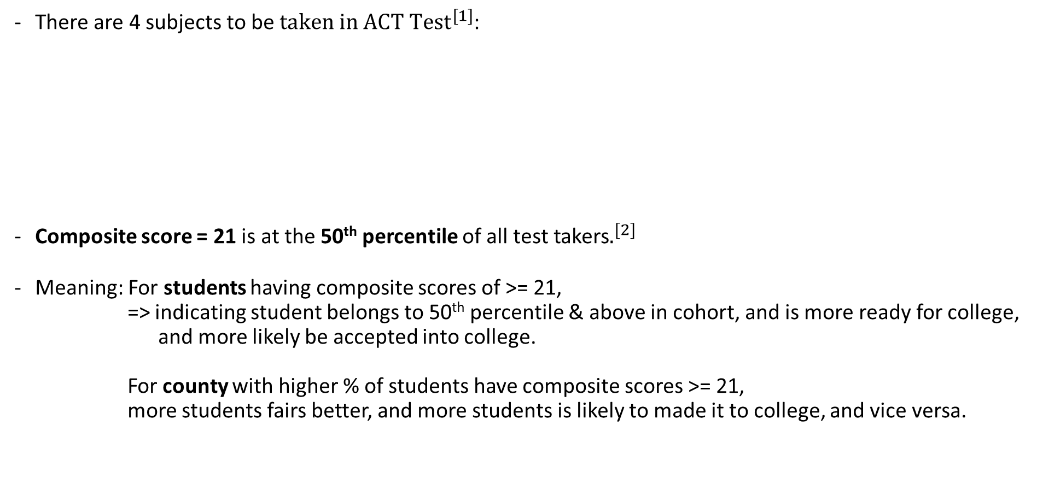
ACT Test
There are 4 subjects to be ${taken in ACT Test}^{[1]}$:
Composite score = 21 is at the 50th percentile of all test takers$.^{[2]}$
Meaning: For students having composite scores of >= 21,
=> indicating student belongs to 50th percentile & above in cohort, and is more ready for college,
and more likely be accepted into college.
For county with higher % of students have composite scores >= 21,
more students fairs better, and more students is likely to made it to college, and vice versa.
Subjects | Score Range (corresponds to percentile that compares within test takers) | Composite Score
English | 1 - 36 | Average Score of these 4 subjects
Math | 1 - 36 | 530
Reading | 1 - 36
Science | 1 - 36
[1] ACT Understanding your scores https://www.act.org/content/act/en/products-and-services/the-act/scores/understanding-your-scores.html
[2] What is a good ACT score? A bad ACT score? An excellent ACT score? https://blog.prepscholar.com/what-is-a-good-act-score-a-bad-act-score-an-excellent-act-score

Slide 13
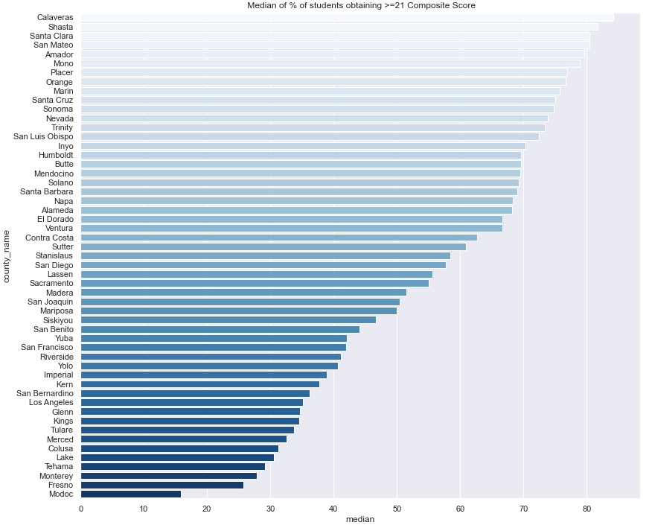
ACT Test (County Analysis)
Among the 53 counties in California, the bottom 5 counties in terms of median % of students obtaining >=21 composite scores:
Modoc – 15.8%
Fresno – 25.7%
Monterey – 27.9%
Tehama – 29.2%
Lake – 30.6%

Slide 14
ACT Test (County Analysis)
Among the 53 counties in California, the bottom 5 counties in terms of median % of students obtaining >=21 composite scores:
Modoc – 15.8%
Fresno – 25.7%
Monterey – 27.9%
Tehama – 29.2%
Lake – 30.6%
Recommendations:
Focus on allocating more and higher quality teaching resources to these 5 counties in urgent need.

Slide 15
ACT Test (County Analysis)
Among the 53 counties in California, the bottom 5 counties in terms of median % of students obtaining >=21 composite scores:
Modoc – 15.8%
Fresno – 25.7%
Monterey – 27.9%
Tehama – 29.2%
Lake – 30.6%
Recommendations:
Focus on allocating more and higher quality teaching resources to these 5 counties in urgent need.
If there are additional teaching resources, the government can also focus on the next 9 counties which have 30-40% of median % of students obtaining >=21 composite scores.

Slide 16
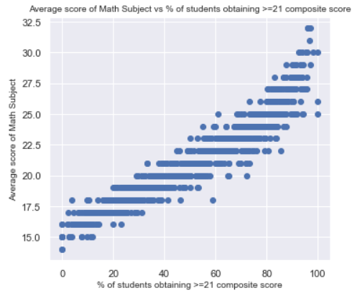
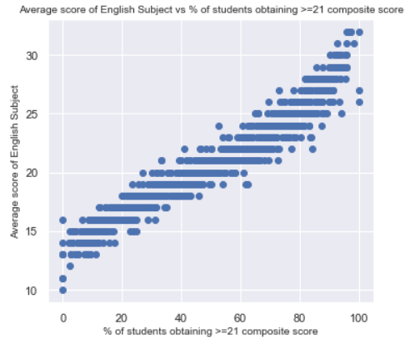
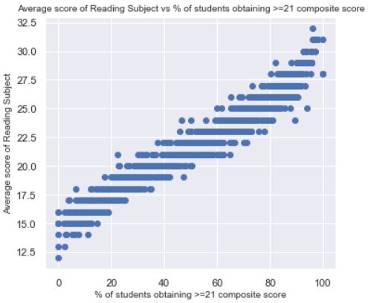
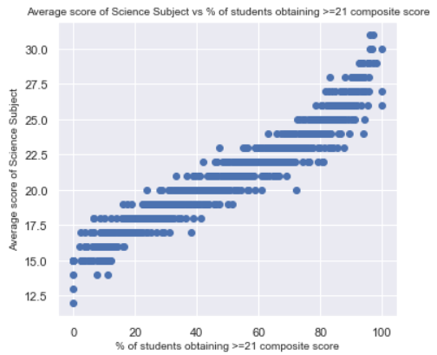
ACT Test (Subject Analysis)
Math
English
The charts on the right are relationship of each subject’s average score with the % of students obtaining >=21 composite score.
All 4 subjects shows strong +ve linear correlation to % of students obtaining >=21 composite score, suggesting that to increase the % of students obtaining >=21 composite scores, all the 4 subjects are equally important.
Reading
Science

Slide 17
ACT Test (Subject Analysis)
Math
English
The charts on the right are relationship of each subject’s average score with the % of students obtaining >=21 composite score.
All 4 subjects shows strong +ve linear correlation to % of students obtaining >=21 composite score, suggesting that to increase the % of students obtaining >=21 composite scores, all the 4 subjects are equally important.
Recommendations:
- For students in need, the state will need to provide additional or higher quality teaching resources for all 4 subjects.
Reading
Science

Slide 18
Conclusion & Recommendations
To improve college enrollment rate in California:
Can improve the college admission test results of students.
SAT Test
Government can focus on allocating more and higher quality teaching resources to the bottom 5 counties in SAT performance, namely Colusa, Glenn, Fresno, Los Angeles and Monterey.
For students in need, the state will need to provide additional or higher quality teaching resources for both Math and ERW subjects.
Throughout the state, government need to improve quality of current teaching resources in Math.
ACT Test
Government can focus on allocating more and higher quality teaching resources to the bottom 5 counties in ACT performance, namely Modoc, Fresno, Monterey, Tehama and Lake.
For students in need, the state will need to provide additional or higher quality teaching resources for all 4 subjects (Math, English, Reading, Science).

Slide 19
Thank you!

